Slide 1
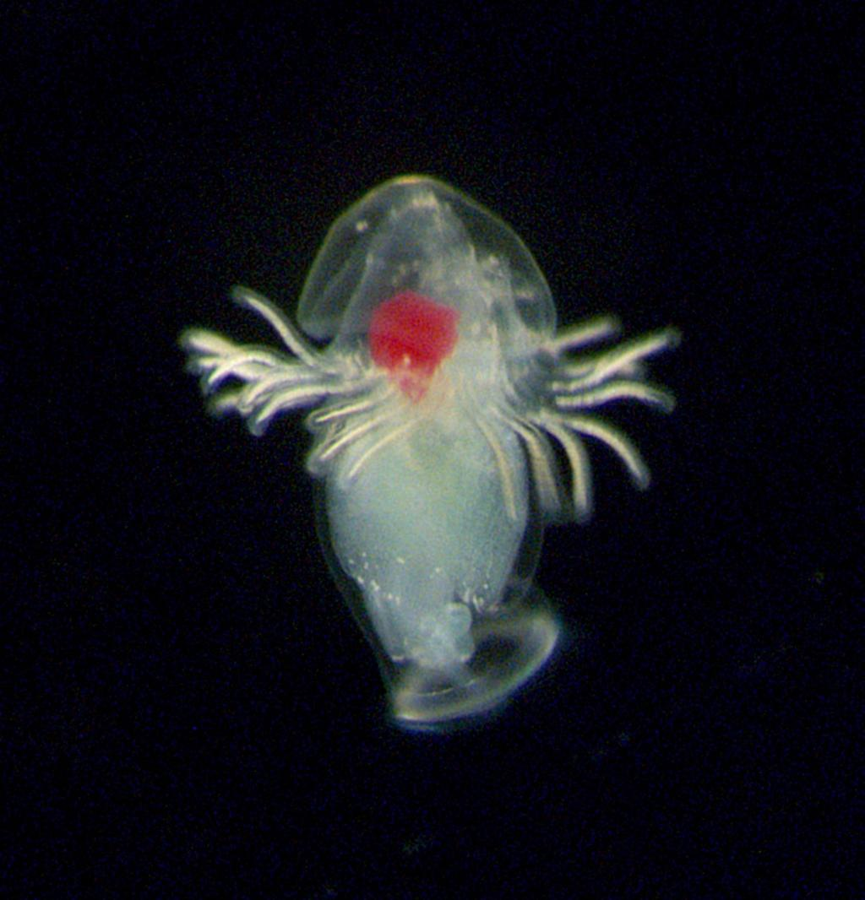
BIN Diversity in Phoronida (Horseshoe Worms): Canada vs Panama
Sharon Tsukernik

Slide 2
Introduction
How does the BIN diversity differ between Phoronida sampled from Panama (tropical) vs Canada (temperate)?
140 samples taken from Panama
15 samples taken from Canada
Want to explore the difference in species diversity between the two countries
  Comparing unique BINs
  Comparing latitude and longitude

Slide 3
Introduction
Why Study Phoronida?
Key to understanding lophophorate evolution [1]
  Helps clarify long-debated phylogenetic placements [1]
Used to study numerous developmental, physiological and morphological traits [1]
Bridge between morphology and genomics
  Genetically diverse but morphologically uniform [1]
Global phoronid diversity is underestimated [2]
  Least number of species of the high-rank animal clades [1]
  Undescribed phoronid lineages in waters [2]
Small phylum
  Need for continued sampling to add to diversity [2]

Slide 4
Introduction
Studying Phoronida helps answer fundamental questions about:
The true scale of marine biodiversity, especially in underexplored tropical and temperate regions
How genetics can reveal hidden relationships and cryptic species
The evolution of the developmental systems in the larvae and adults

Slide 5

Methods
There are around 280 Phoronida records from BOLD
Downloaded data and isolated columns that were of use for the analysis
Sorted between unique species and BINs from Panama vs Canada
Constructed a bar graph to compare how many samples were taken from each country
Created another bar graph to compare number of unique BINs in each country
Plotted accumulation curve to estimate total species richness
Used a Wilcoxon test to test a statistical difference between latitude and longitude of Canada and Panama
Analyzed the results to compare BIN diversity between Panama and Canada

Slide 6
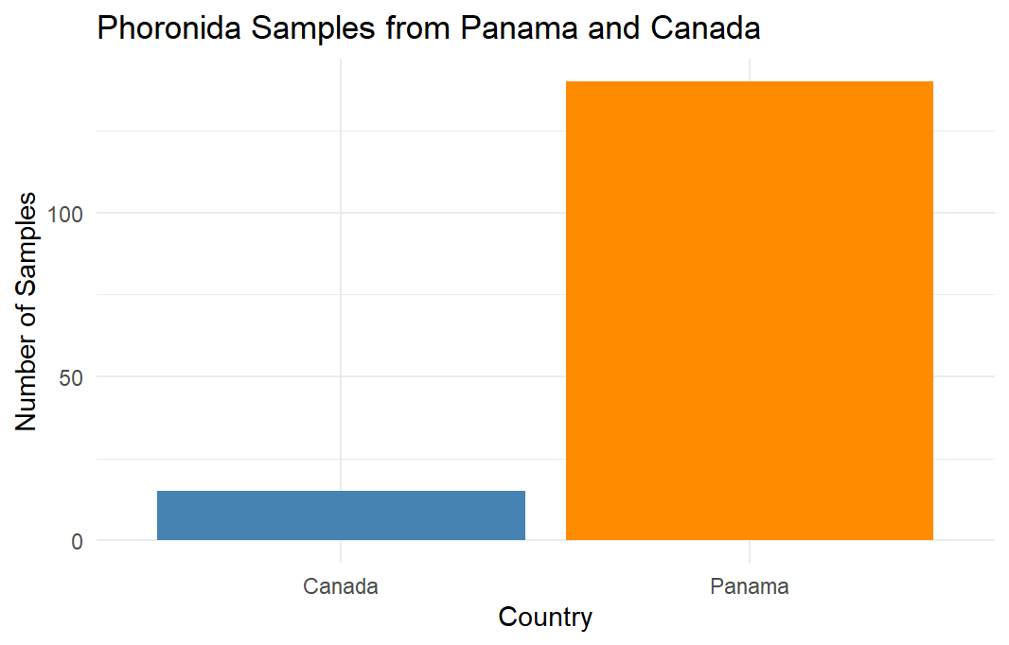
Panama Had Significantly More Samples Collected Compared to Canada
Figure 1

Slide 7
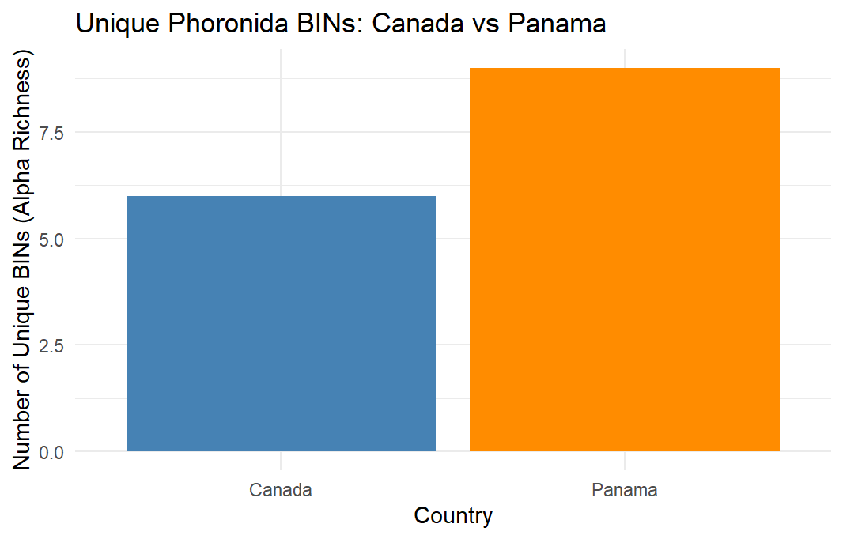
Panama Shows Higher BIN Richness Than Canada, Suggesting Greater Diversity
Figure 2

Slide 8
Results and Discussion - Boxplots
There are significantly more samples that were taken from Panama in comparison to Canada
  The sampling effort or available data/resources was greater in Panama
This can skew the BIN diversity results since a larger sample size has more potential for diversity, but it doesn’t necessarily mean that Panama has greater diversity
Suggests that any comparison made between the samples must be accounted for sampling bias
There are more unique BINs that were sampled from Panama compared to Canada
  Suggests that Panama has a greater species diversity
  To truly be able to interpret this, it would have to be assumed that there was an equal number of samples taken between both countries
Tropical regions (Panama) may host higher Phoronida diversity than temperate regions (Canada)
  Diversity may be influenced by different environmental conditions
There is an incomplete representation if sampling is limited geographically
These results can’t be interpreted accurately since there is unequal sampling and potential biases involved
If there were more samples taken from Canada, there could be a higher BIN diversity in comparison to Panama
  Would need to increase sampling size to confirm this

Slide 9
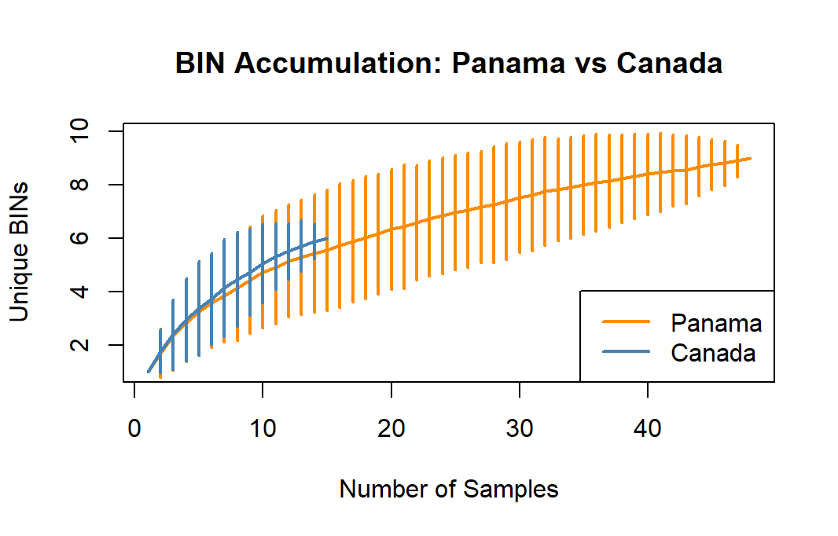
BIN Accumulation Increases More Steeply in Panama, but Canada Initially Shows Higher Diversity Per Sample
Figure 3

Slide 10
Results and Discussion - Accumulation Curve
Panama continues to gain unique BINs as the sample size increases, meanwhile Canada starts to level off earlier
  The rising curve in Panama implies incomplete sampling
Can indicate that Panama has higher species diversity and that additional sampling would continue to reveal more BINs
  Would need to collect more data from Canada to confirm a more accurate number for alpha richness in Phoronida
  Panama had more samples, so overall trend reveals a higher number of unique BINs
The curve representing Canada begins to flatten early (around 6 BINs), which may suggest that most of the Phoronida diversity that resides there has already been captured within the samples
All these results can’t be read with 100% accuracy due to the big difference between sampling size
  Allows for Panama to have a longer curve and potentially more variety
When both sample sizes reach 15, the BIN diversity is higher in Canada compared to Panama
  Can suggest that the initial samples taken from Canada contributed to more new BINs than the early samples taken from Panama
Overall, omitting different samples sizes, the trend suggest that tropical regions like Panama may host a higher number of genetically diverse Phoronida in comparison to temperate regions like Canada
Studies have shown that there more species that haven’t been sampled in Panama [2]
  This confirms that the accumulation curve could start to flatten out once more species are being sampled

Slide 11
Results and Discussion – Wilcoxon Test
Latitude:
  p-value = 2.808e-12
  small p-value means the difference is highly statistically significant
  interpretation: latitudes of samples from Panama and Canada differ significantly - which makes sense since Panama in near the equator (low latitudes) and Canada is much farther north (high latitudes)
  Results validate that the two sampling regions represent two different environmental zones (temperate vs tropical)
Longitude:
  p-value = 2.808e-12
  small p-value, so the difference in longitudes between the two countries is statistically significant
  Interpretation: sampling sites in Panama and Canada are geographically distinct along the east–west axis (longitude)
  Results reinforce that Canada and Panama are located in different oceanic regions, so samples were taken from varying conditions
Adult phoronids are found in most of the world’s oceans, in both temperate and tropical regions [2]
  Overall, the two datasets represent populations that are geographically and environmentally distinct

Slide 12
Acknowledgements
Sabrina: helped me brainstorm project ideas, and helped me find errors in my code
  I was able to pick an interesting topic and correct any bugs so that my script can run smoothly
Nicholas: advised me to run a Wilcoxon test
  I was able to figure out how to conduct this test and therefore get a statistical significance of the locations where the samples were taken
Farah: assisted in explaining how to save my graphs
  I was having a hard time saving my accumulation curve, but she showed me the syntax and after some trial and error, I was able to save it properly
Liona: ran my script to make sure everything was smooth
  I was able to find minor errors that didn’t run on their computers and correct said errors
Eva: helped me understand how to inspect my data by country
  I was able to compare how many unique species and BINs existed in my two countries of interest

Slide 13
References
[1] Gąsiorowski, L. (2024). Phoronida—A small clade with a big role in understanding the evolution of lophophorates. Evolution & Development, 26(4), e12437-n/a. https://doi.org/10.1111/ede.12437
[2] Collin, R., Venera-Pontón, D. E., Driskell, A. C., Macdonald, K. S., Chan, K.-Y. K., & Boyle, M. J. (2019). Documenting neotropical diversity of phoronids with DNA barcoding of planktonic larvae. Invertebrate Biology, 138(2), 1–15. https://doi.org/10.1111/ivb.12242

